Slide 1
BIAS IN MOLECULAR EPIDEMIOLOGY
A story in three parts
Part I
How Bias Shapes What We Observe
Public health molecular epidemiology
Justin Bahl
Notes:
Series title: Bias in Molecular Epidemiology: A story in three parts
Part I: How Bias Shapes What We Observe

Slide 2
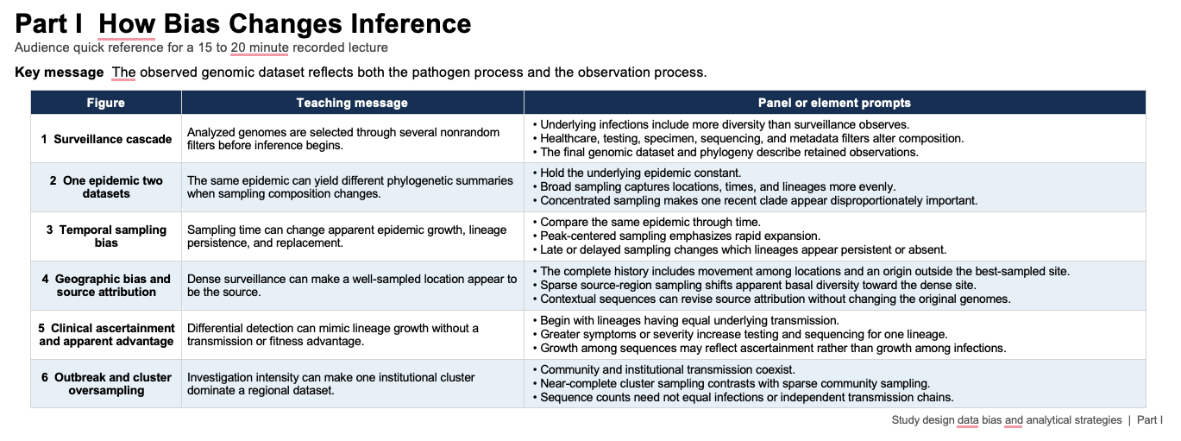
Bias_in MolEpi_Quick_Reference.docx

Slide 3
Purpose and learning objectives
How can the observation process change the apparent epidemic without changing the epidemic itself?
Locate the major selection points between infection and an analyzed genome
Recognize how time, place, clinical ascertainment, and outbreak investigation alter observed patterns
Separate sequence abundance from population abundance, source, and lineage growth
Identify conclusions that require independent epidemiologic evidence
Part I How Bias Shapes What We Observe
2
Notes:
Central question: How can the observation process change the apparent epidemic without changing the epidemic itself?
Learning objectives:
- Locate the major selection points between infection and an analyzed genome
- Recognize how time, place, clinical ascertainment, and outbreak investigation alter observed patterns
- Separate sequence abundance from population abundance, source, and lineage growth
- Identify conclusions that require independent epidemiologic evidence

Slide 4
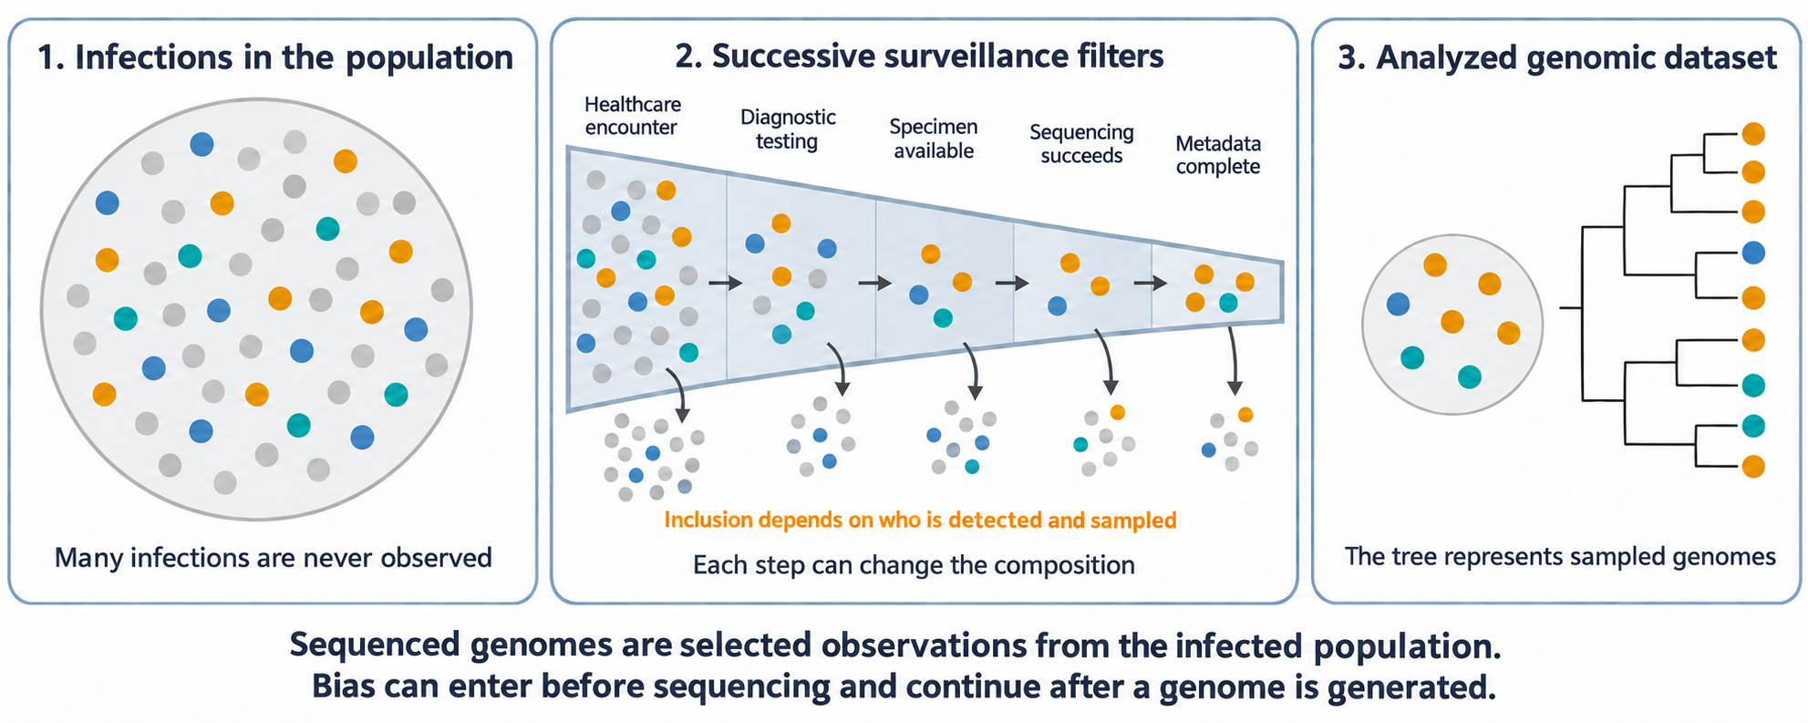
Figure 1
Surveillance cascade
Analyzed genomes pass through several nonrandom filters before inference begins.
4
Notes:
Teaching message: Analyzed genomes pass through several nonrandom filters before inference begins.
Panel prompts:
- Underlying infections contain more diversity than surveillance observes.
- Healthcare, testing, specimen, sequencing, and metadata filters alter composition.
- The final genomic dataset describes retained observations.

Slide 5
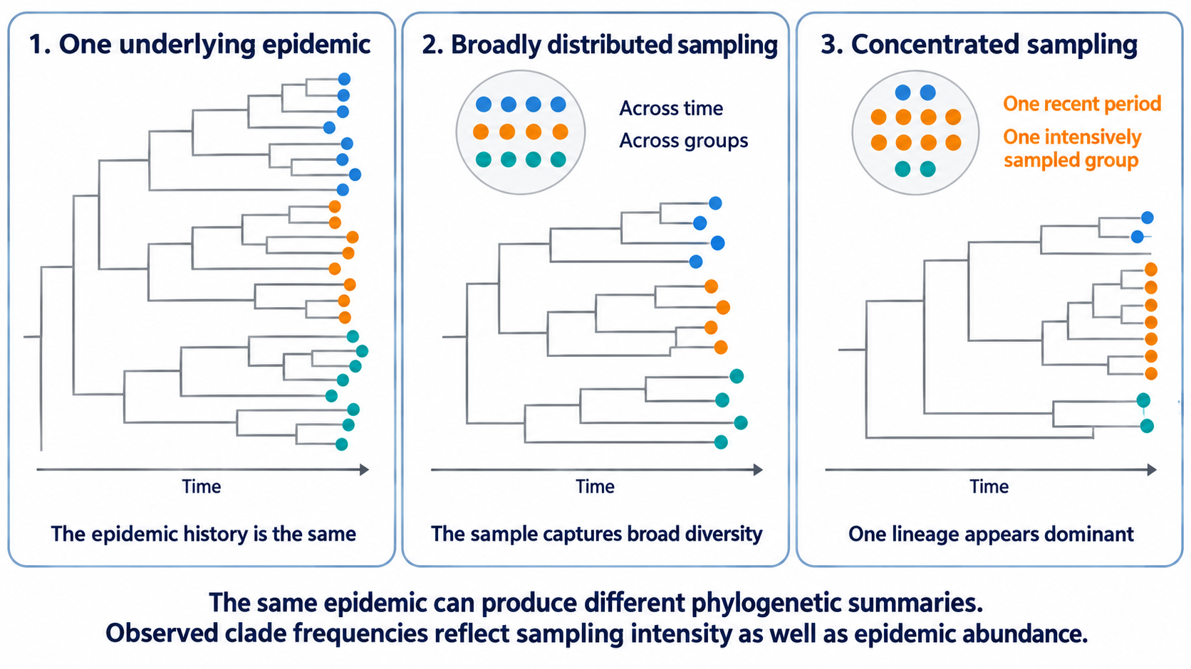
Figure 2
One epidemic, two datasets
Sampling composition can produce different phylogenetic summaries of the same epidemic.
5
Notes:
Teaching message: Sampling composition can produce different phylogenetic summaries of the same epidemic.
Panel prompts:
- Hold the underlying epidemic constant.
- Compare broad sampling with concentrated sampling.
- Apparent clade dominance can arise from composition alone.

Slide 6
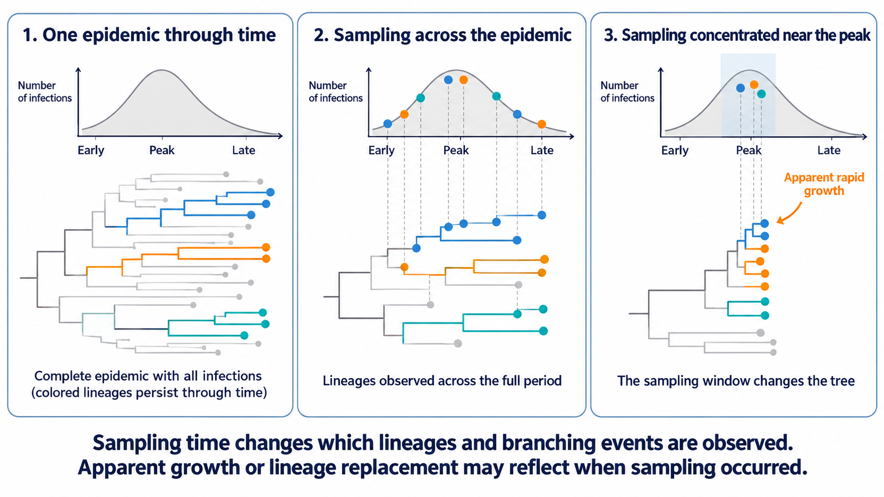
Figure 3
Temporal sampling bias
Sampling time can change apparent growth, lineage persistence, and replacement.
6
Notes:
Teaching message: Sampling time can change apparent growth, lineage persistence, and replacement.
Panel prompts:
- Compare the same epidemic through time.
- Peak-centered sampling emphasizes rapid expansion.
- Delayed sampling changes which lineages appear persistent or absent.

Slide 7
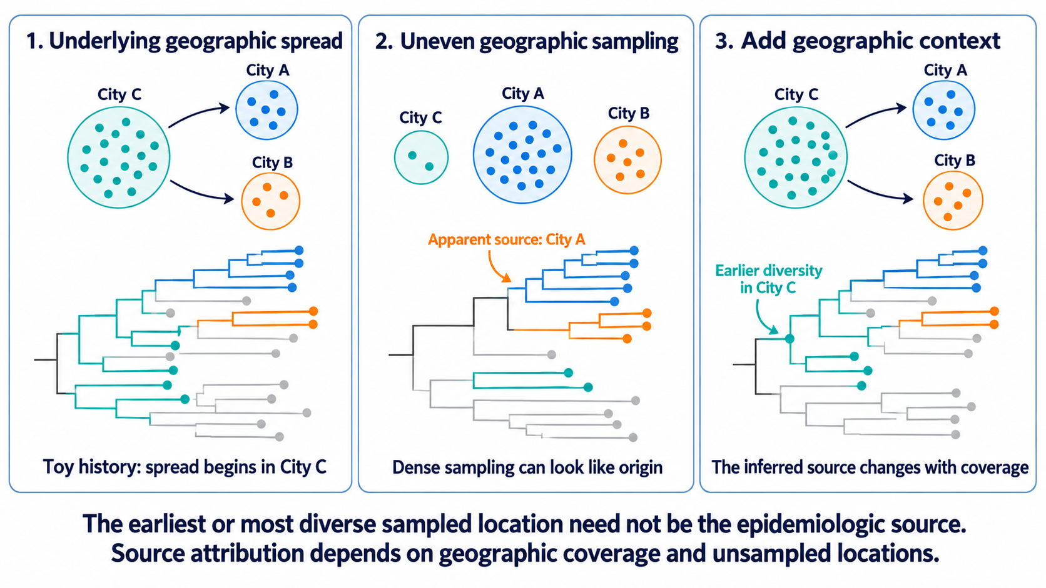
Figure 4
Geographic bias and source attribution
Dense surveillance can make a well-sampled location appear to be the source.
7
Notes:
Teaching message: Dense surveillance can make a well-sampled location appear to be the source.
Panel prompts:
- Contrast the complete movement history with sparse sampling of the true origin.
- Show why basal placement is conditional on the surveillance frame.
- Add contextual sequences and reassess the source claim.

Slide 8
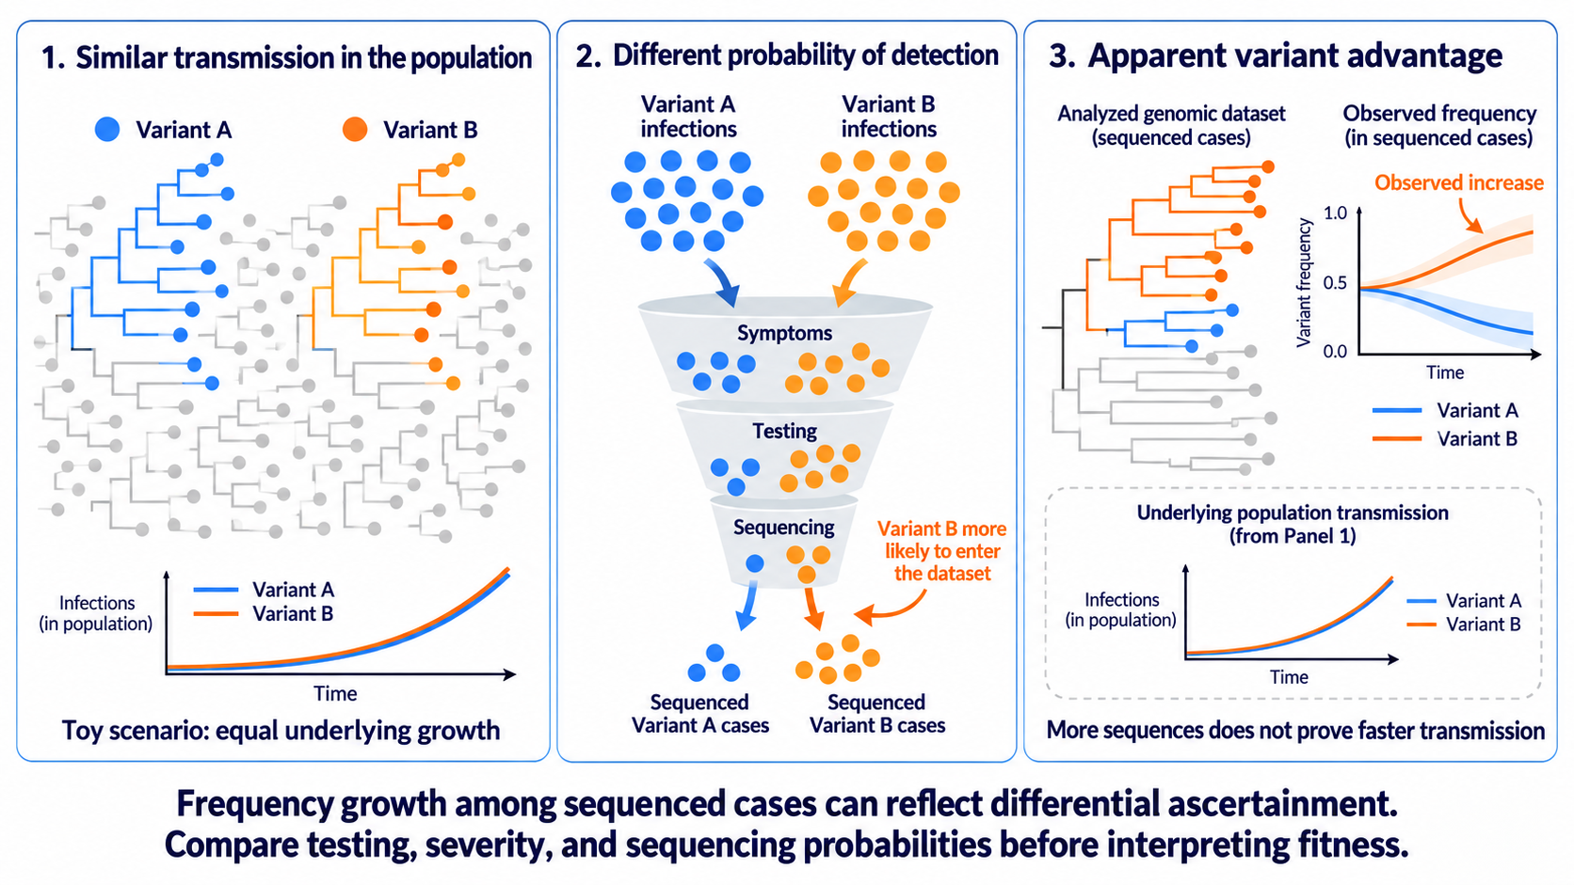
Figure 5
Clinical ascertainment and apparent lineage advantage
Differential detection can mimic lineage growth without a transmission or fitness advantage.
8
Notes:
Teaching message: Differential detection can mimic lineage growth without a transmission or fitness advantage.
Panel prompts:
- Begin with equal underlying transmission.
- Increase testing or sequencing for the more symptomatic lineage.
- Separate growth among sequences from growth among infections.

Slide 9
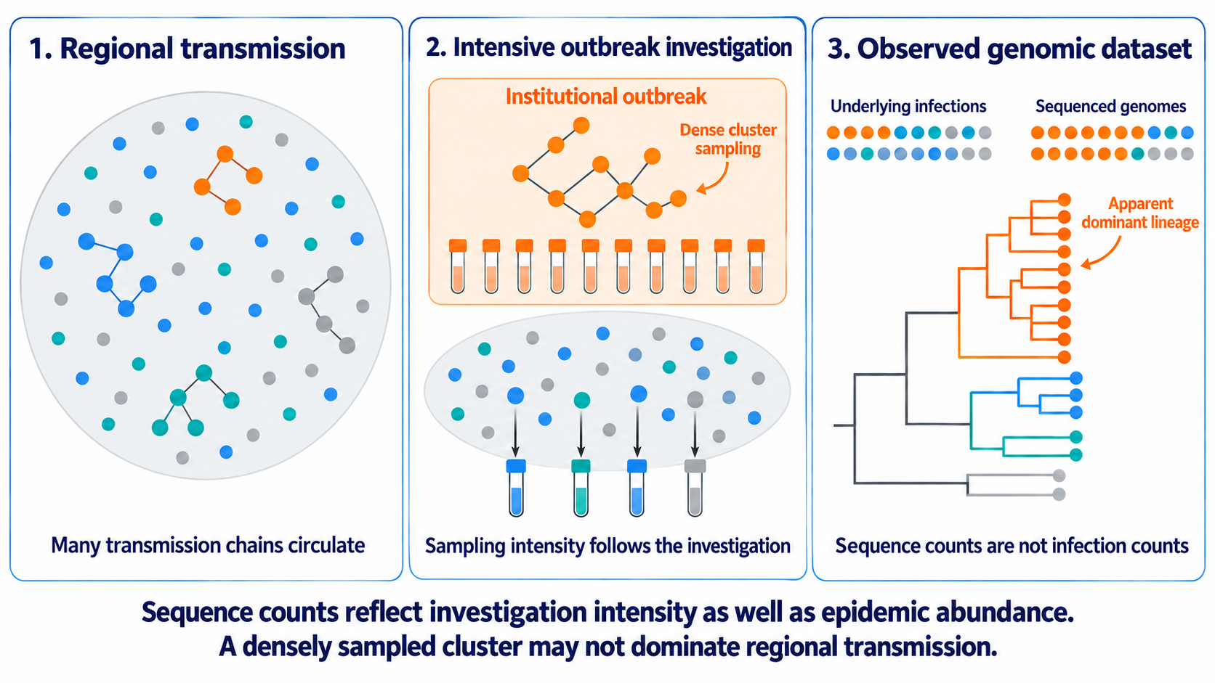
Figure 6
Outbreak and cluster oversampling
Investigation intensity can make one cluster dominate a regional dataset.
9
Notes:
Teaching message: Investigation intensity can make one cluster dominate a regional dataset.
Panel prompts:
- Community and institutional transmission coexist.
- Near-complete cluster sampling contrasts with sparse community sampling.
- Sequence counts do not equal infections or independent transmission chains.

Slide 10
Key takeaways
The observed dataset reflects the pathogen process and the observation process.
Sampling can alter apparent frequency, growth, geographic structure, and source attribution.
Genomic patterns require epidemiologic context before they support causal interpretation.
Part I How Bias Shapes What We Observe
Bias in Molecular Epidemiology: A story in three parts
10
Notes:
Closing takeaways:
- The observed dataset reflects the pathogen process and the observation process.
- Sampling can alter apparent frequency, growth, geographic structure, and source attribution.
- Genomic patterns require epidemiologic context before they support causal interpretation.

